Slide 1
Network Security
Spring 2025

Slide 2
TCP 3-way handshake
TCP SYN
When host receives a TCP SYN packet
Open sockets
Allocating resources (CPU/memory) to prepare for the connect
TCP SYN/ACK
TCP ACK

Slide 3
Task 1a. SYN Flood Attack
TCP SYN
TCP SYN
Server will allocate resources for each TCP SYN received. Will soon run out of resources
TCP SYN
TCP SYN
TCP SYN
TCP SYN
TCP SYN
TCP SYN
Attacker
(Trudy)
TCP SYN
TCP SYN
TCP SYN
TCP SYN
Size of a TCP SYN Packet: 40 bytes (IP header=20b + TCP header 20b)
TCP SYN Flood attacks are very easy to perform, and a normal computer has 40 available sockets

Slide 4
Task 1b: mitigate a SYN Flood attack: SYN Cookies
SYN:SYN=ISN_{A}
With SYN Cookie protections are on: When Host B received a TCP SYN
It does NOT allocate resources yet
It sends a SYN Cookie
Only when host B received the SYN cookie back
Does it allocate a socket for the connection
SYN-ACK with ISN_{B}= cookie
Host A
Host B
ACK: cookie + 1

Slide 5
726 Broadway, 8th Floor – ITS
1 Metrotech Center, 22nd Floor
noc-its18-arin@nyu.edu
noc-cosi-arin@nyu.edu
+1-212-998-34
+1-212-998-344431
216.165.0.0/17
AS12 (128.122.0.8)

Slide 6
Engineering.nyu.edu -> hosted by AWS
Brightspace.nyu.edu -> nyu.Brightspace.com -> AWS
Cyber.nyu.edu -> AWS
Albert.nyu.edu -> 216.165.62.30
Hosting.nyu.edu -> DigitalOcean
Stream.nyu.edu -> kltura.com -> cloudflare.net
Mail server: pphosted.com

Slide 7
DNS Record Types
A records – IPv4 IP addres
AAAA – IPv6 IP address
TXT – “free text”, often used for email security (SPF)
CNAME – similar to alias
NS – DNS servers for the domain
MX – mail server

Slide 8
Emails to NYU
User
Proofpoint
gmail

Slide 9


ICMP echo request/reply
User
ICMP echo request
Google
8.8.8.8
ICMP echo reply
Lab 2 Task 2
ICMP Echo request
User1
Google
ICMP echo reply

Slide 10








Lab 2 Task 3 – write your own traceroute program
SEED machine
Google DNS Server
8.8.8.8
Icmp ping TTL 1
Icmp ping TLL 2
..
…
….
Task 3, the sample code does not handle when there is no reply properly (program will hang)

Slide 11


Lab 2 Task 4
User
ICMP request
Google
8.8.8.8
Part 3
When the user tries to ping 8.8.8.8, the user will receive two icmp echo replies: 1. is from the real google DNS
2. Is from the attacker (that’s you)
ICMP echo reply
ICMP echo reply
Attacker
When the user tries to ping 1.2.3.4
There is no response (probably host doesn’t exist)
ICMP echo reply
User
1.2.3.4
Part 1
ICMP request
No reply

Slide 12
User 10.9.0.x
ARP Ping (ARP Request)
10.9.0.99
Part 2
No reply
Attacker
(sniffing ICMP echo request)

Slide 13
TCP Port scanning (1)
TCP SYN dport 443
Normal process for
Port 443 is open
TCP SYN/ACK
TCP ACK
TCP SYN dport 443
TCP RST
Port 443 is closed
Gets a TCP RST

Slide 14
TCP port scanning (2)
ICMP destination unreachable
Networking error (route not found, host does not exist)
“Rejected” by a Firewall
TCP SYN dport 443
ICMP destination unreachable
No response
Networking error (route not found, host does not exist)
“Drop” by a Firewall
TCP SYN dport 443
(no response)

Slide 15
REJECT or DROP
REJECT
Firewall is being nice, is sending a ICMP destination unreachable
DROP
The packet is ”being sent to the bit bucket”
Firewall is not responding at all

Slide 16
Nmap SYN Scan vs. Connect Scan
SYN Scan
Nmap has elevated privilege
Can write directly to the network
TCP SYN dport 443
(nmap listens for a response)
TCP SYN dport 443
TCP SYN/ACK
TCP ACK
TCP Connect Scan
Nmap does not have elevated privileges
Must use OS API (sockets) to open/close ports
TCP FIN
TCP FIN/ACK
TCP ACK

Slide 17








Nmap ACK Scan – only works on stateless firewalls
Flags: SYN/ACK
TCP port 443
Flags: SYN/ACK
FW
RST
Attacker tries to connect to port 443
(TCP SYN will get blocked
When an attacker tries to connect to host in port 443,
It will be blocked by the FW, because it only allows outgoing
Connects to port 443, not incoming connections
Attacker connect to port 443
Using TCP ”ACK” flag only
When the attacker tries to connect to port 443,
Using TCP “ACK” packet, it will be allowed through the firewall
Becaue the firewall must allow TCP ACK to come into the network
Due to allowing port 443 to go out of the network.
If successful, the host will reply back to the attacker with a. RST packet

Slide 18








Attackers pivot to other hosts

Slide 19
UDP Scanning
UDP DNS port 53
Port is open
Send a request, get a response
DNS Response
UDP DNS port 53
Port is closed
ICMP Destination unreachable is received
ICMP Destination Unreachable
*
UDP DNS port 53
No response
Firewall is blocking port
Improperly formatted request
ICMP Destination unreachable limit
Limited: 1/s in Linux or 2/s in Winodws
(no response)
* don’t get confused with TCP ICMP unreachable

Slide 20










ICMP Destination Unreachable
ICMP Destination Unreachable are limited
Windows: 2 times / sec
Linux 1 time / sec
If you sent two UDP packets to two closed ports at the same time, only the first one will response. The 2nd response is DROPed
Victim
Trudy sends a broadcast request

Slide 21
Remote Scanning vs. Agent-based scanning
Remote scanning
Traditional scanning method
It is very slow for UDP
Agent-based scan
Must better and faster
Can list all ports/services quickly
Cost is approximately 10x more
Port scans coming from outside
Scanner
Target

Slide 22
SYN Cookies
TCP SYN
SEQ: ISN A (random number)
ACK: 0 (literal “0”, b/c there’s no ACK flag set)
When SYN Cookies are enabled
Upon receipt of a TCP SYN
The host will generate a SYN Cookie
TCP SYN/ACK
SEQ: ISN B ( SYN cookie)
ACK: A+1
SYN_cookie = md5(IPs,ports,slow_time,magic)
All the info is forgotten.
If a SYN_cookie is returned in the TCP ACK packet
Host will recalculate the SYN_cookie, and see if it matches the SYN_cookie from the TCP ACK
Only if the correct SYN cookie is returned, will a socket be opened.
TCP ACK
SEQ: A+1
ACK: B+1 (SYN_cookie + 1)

Slide 23



DNS Amplification/Reflection attack
DNS request 60-80b
TXT Record
Response size: up to 512 bytes
DNS server
request
reply
request
DNS server
reply
request
attacker
reply
DNS server
victim
request
reply
Source IP = Victim’s IP
DNS server
Notes:
Large TXT field; forgeability UDP addresses, the availability of open resolvers, and the asymmetry of DNS requests and responses

Slide 24
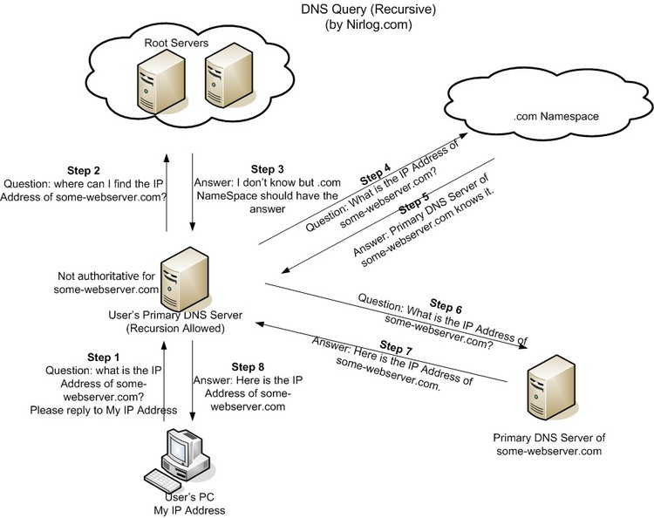







Interlude: How DNS Works
For the attacker to perform a DNS cache poisoning, the attacker must:
Must respond back faster than the real DNS server (very easy if on the same network, hard if not on the same network)
Spoof the real DNS Server’s IP address (very easy)
Use the same Transaction ID & port# as the DNS packet (easy if you can read the packets, hard if you cannot read the packets)
Fake engineering.nyu.edu
Trudy

Slide 25


Interlude: How DNS Works
Fake engineering.nyu.edu
Trudy

Slide 26






Interlude: How DNS Works
Fake engineering.nyu.edu
Fake NYU.edu NS server
Another victim
Trudy

Slide 27
Cover_tcp
1. IP ID method – random 16-bit number in the IP header, used for reassembling fragmented packets.
2. SEQ# Method (32-bits)
Every IP packet has a IP ID #. The sender can choose a new IP ID per packet
IP ID: “HELO” (16 bits) – IP header
Sender
Recipient
Every new TCP connection has a SEQ number chooses initially (called a ISN).
TCP SEQ#: “HELOWORD” - TCP Header
Sender
Recipient

Slide 28
Cover_tcp (cont)
3. ACK # Method
Innocent Bystander
TCP SYN/ACK
SEQ: ISN B
ACK: “HELLO” + 1
TCP SYN
SEQ: “HELLO” (in ascii)
Source IP: recipient
Recipient, upon receiving “HELLO” + 1, knows that the original message was “HELLO”
Sender
Recipient

